Slide 1


Adopt a Hole
Golf Canada & Mississaugua need your help!
Join our team!
Marshal one hole for the
2025 CPKC Women’s Open
August 18-24, 2025 at the
Mississaugua Golf and Country Club

Slide 2


Responsibility of your club
Recruit 20 volunteers from the members, families, and friends of your club. These volunteers must register in the volunteer registration system.
Select one person to serve as the Hole Captain and be the main point of contact for the group.
Manage the marshalling of a designated hole during tournament week.
Participate as part of the Marshal team and with the Mississaugua Marshal Committee Chair

Slide 3

Hole Captain
Role & Responsibility
    Manage the group volunteers who marshal the selected Hole.
    Act as the contact between your group and the Mississaugua Marshall Committee Chair, MMCC.
    Develop volunteer assignments.
    Determining availability and schedule volunteers.
    Orient volunteers before the tournament to the specific hole.
    Supervise volunteers during the tournament
    Ensure volunteers are rotated appropriately on the hole and that volunteers receive appropriate breaks during their shift.
    Discuss issues and concerns with MMCC and Area Captain.

Slide 4

Area Captain
Role and Responsibility
Appointed by the Host Mississaugua Golf & Country Club
Assigned several holes to support each Hole Captain on the assigned hole
Onsite throughout the tournament
Drive around and liaison with the Hole Captains
Communicate with the Hole Captains
Troubleshoot problems and issues
Find the appropriate resource for problems as communicated from the Hole Captains
Deliver water and equipment as requested

Slide 5
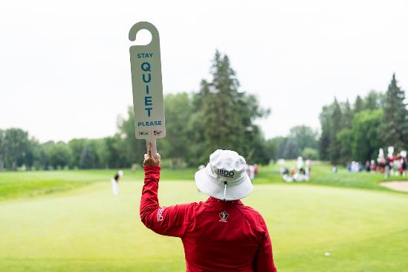
Role of a Marshal
Ensure the smooth operation of the tournament, maintaining a safe and enjoyable environment for players and spectators, and upholding the integrity of the game of golf.

Slide 6
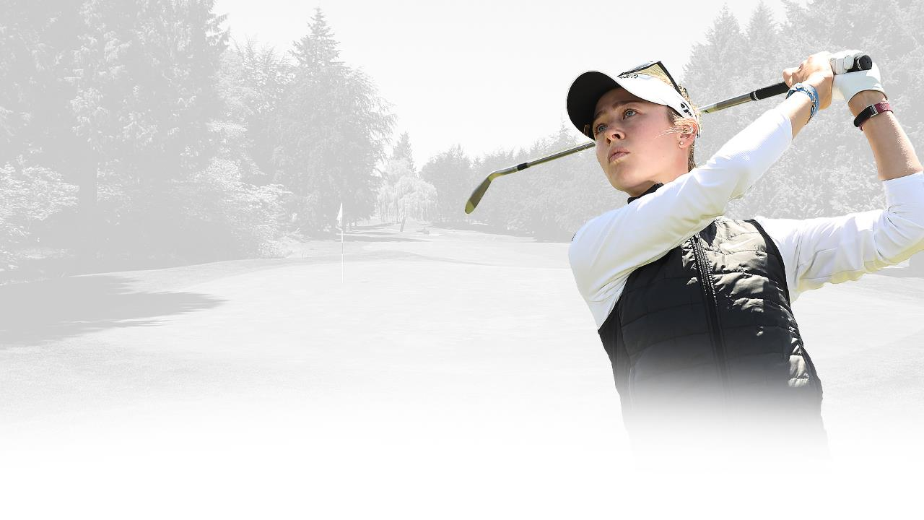
Overall Marshal Responsibilities
Player Assistance: assist players locate their ball to help with pace of play.
  Understand the movement of players and caddies for your hole.
  Understand the movement of spectators around your hole.
Crowd Control: Manage the flow of spectators, ensuring a safe distance from players with no game disruption. Direct spectators to designated viewing areas and assist with crowd management.
  Ensure ropes on your hole are up and stakes are securely in the ground.
Course Safety: Ensure the safety of players, spectators, and other personnel on the course. Identify potential hazards and communicate any safety concerns to tournament officials.
Communication: Act as a communication link between players, officials, and spectators.
Emergency Response: Respond to emergencies or medical incidents alerting appropriate personnel. Assist in directing emergency personnel to the location of an incident and provide support as needed.
Professionalism: Represent the tournament in a professional manner. Wear your volunteer uniform, maintain a positive attitude, and provide exceptional customer service to all individuals involved in the tournament.

Slide 7

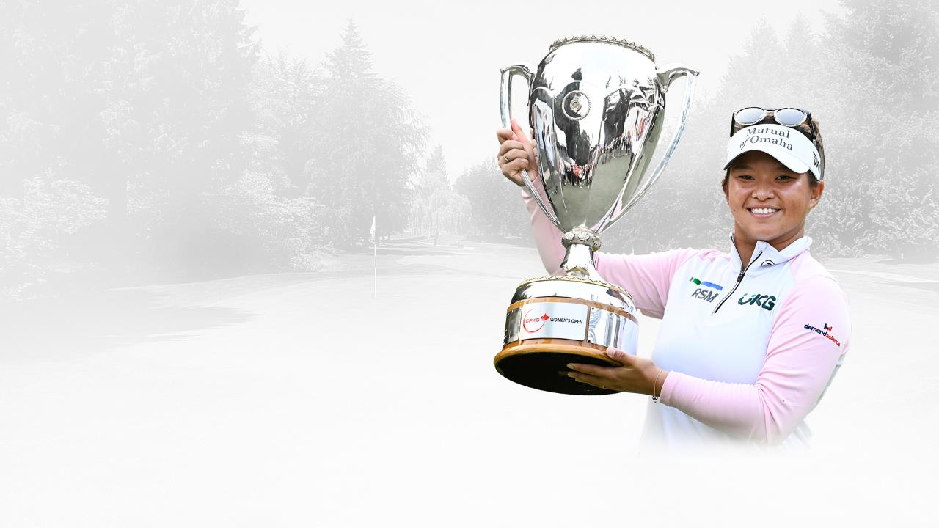
Benefits of Adopting a Hole
Recognition on the tee sign as the organization that has adopted the hole
Network and build relationships with club members and other volunteers.
Inside the ropes experience to watch the LPGAs best players.
Skill Development and further education on the Game of golf.
Community engagement and the opportunity to give back to the game of golf.

Slide 8
Volunteer Information
All volunteers will need to register in the volunteer registration system and pay the fee. The fee covers part of the cost of the volunteer uniform package.
Registration system is available November 4, 2024.
  November 4 – December 3
  Earlybird price $65
  December 4 – July 2025
  Regular price is $80
All marshals need to commit to 4 shifts between the dates of August 19-24, 2025
Volunteer package includes:
Official Volunteer Levelwear Polo​
Official Volunteer Levelwear Hat​
Drawstring Bag​
Lanyard​
Volunteer Accreditation – allows access all tournament week ​
Weekly Guest Pass – transferrable day to day
Week long parking pass​
Pin​
Invitation to Volunteer Appreciation Party​
Meal Voucher for each shift worked

Slide 9
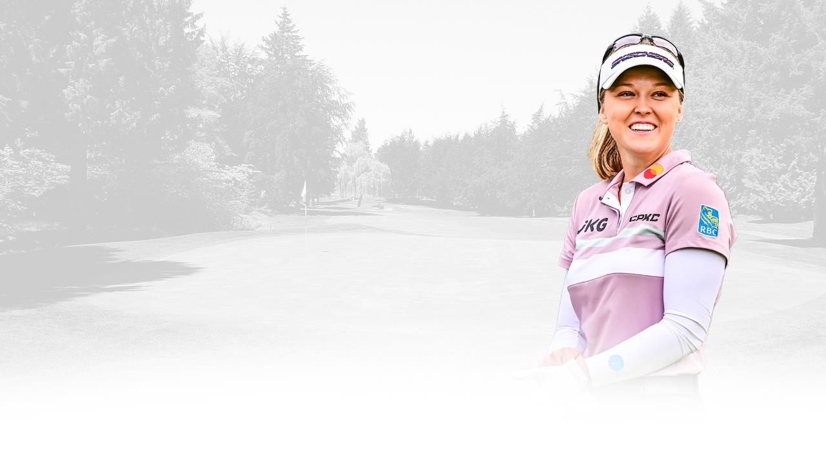
Ready to Adopt a Hole?
Complete the adopt-a-hole intent form and submit to Donna or Hannah.
Donna - donna@donnascully.ca
Hannah - hdaniels@golfcanada.ca

Slide 10









Tee-it-up with us

